Slide 1

Cyber Minutes Weekly
“Lost in the cloud"
11-29-2023 | Jonathan Montoya

Slide 2


Remember it’s still a computer…
Google Drive users reported that files they stored in their cloud account were suddenly gone
Google Drive had reverted to a storage snapshot from April-May 2023
Remember to always store locally offline, as well as a cloud back up
Reported on 11-27-2023 with no update on whether files can be restored

Slide 3

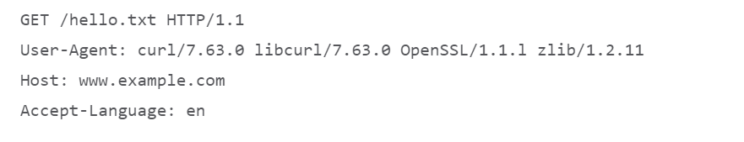
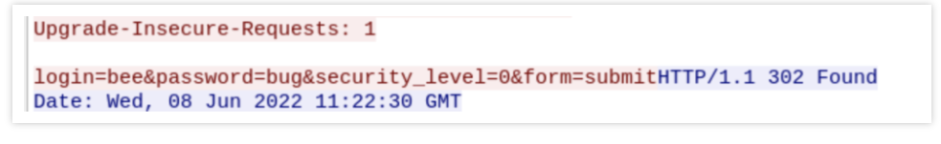
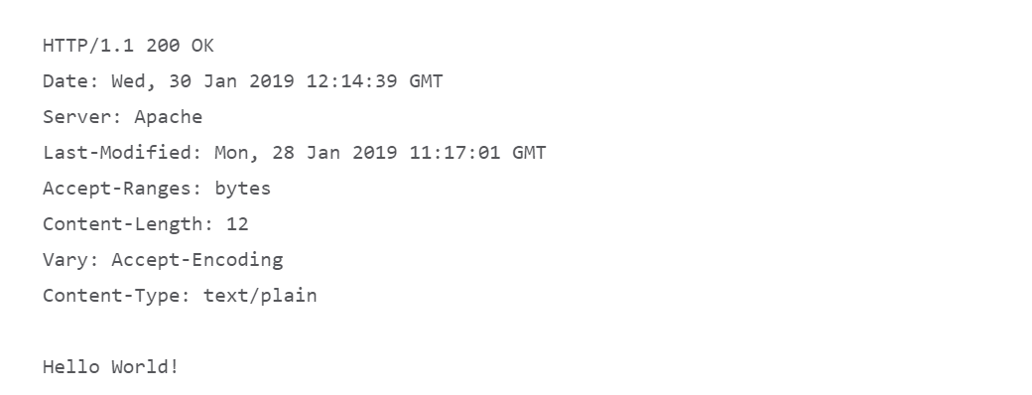
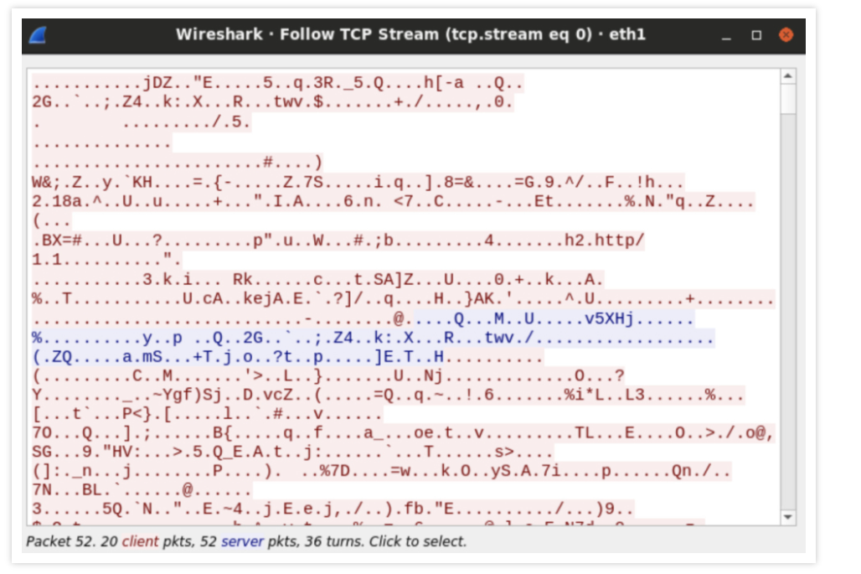
What is the reason for HTTPS?

Slide 4

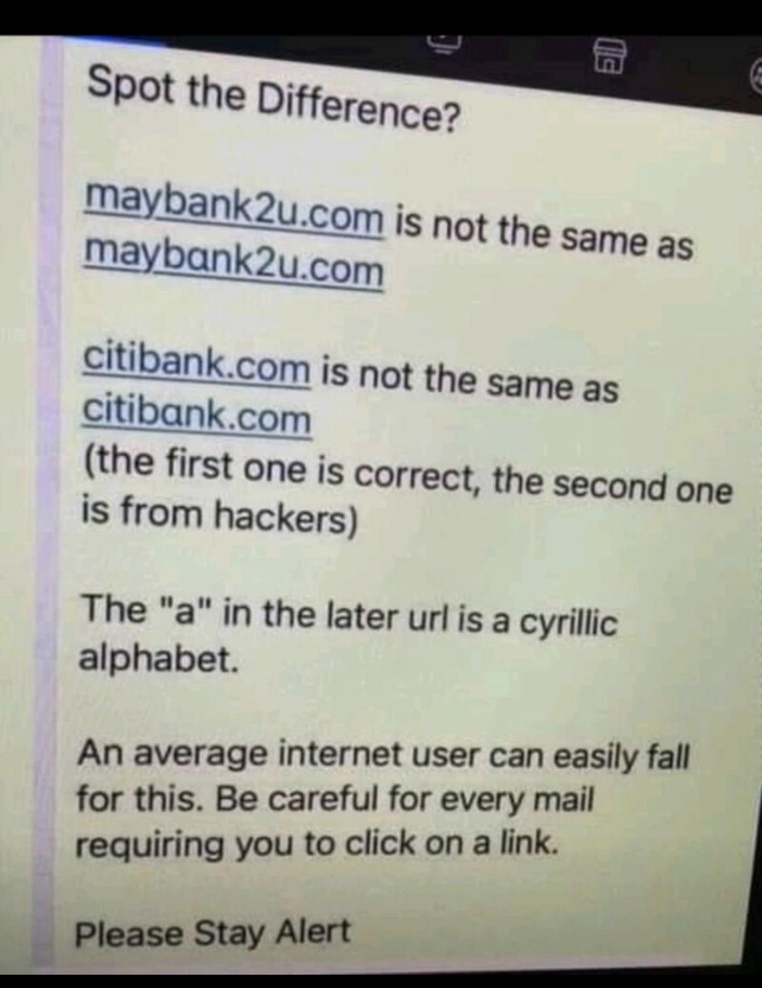
Phishing concerns heading into 2024
50% of phishing websites made use of SSL certificates.
It was identified that 61% of subjects in a study conducted could not differentiate between a real and a fake Amazon login page.
Intelligence is gathered using spear-phishing by 96% of threat actors.
It is estimated that 90% of successful cyber attacks start with email phishing.
Finance & Insurance industry worldwide has a 26.6% click rate when it comes to phishing emails.
Financial Institutions are also the most attacked when it comes to fishing emails at 27.7% of all phishing attacks.

Slide 5
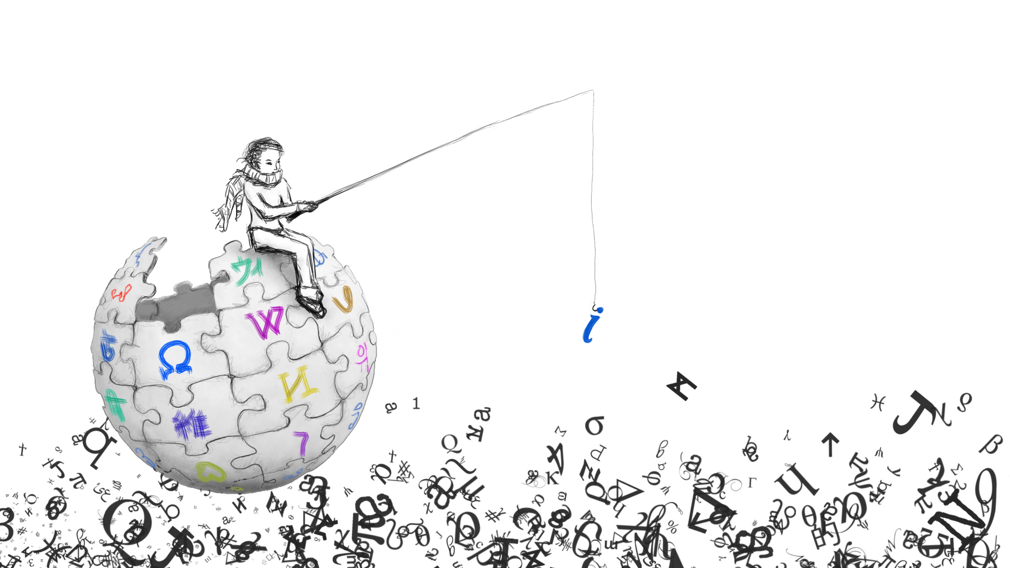
Sources
https://www.bleepingcomputer.com/news/google/google-drive-users-angry-over-losing-months-of-stored-data/
https://www.cloudflare.com/learning/ssl/why-is-http-not-secure/#:~:text=HTTPS%3A%20What%20are%20the%20differences,far%20more%20secure%20than%20HTTP.
https://blog.cloudflare.com/2023-phishing-report/
https://www.stationx.net/phishing-statistics/
https://www.getastra.com/blog/security-audit/phishing-attack-statistics/
https://redcanary.com/threat-detection-report/

